Slide 1
Gene Function & Ontology
PLB 812

Slide 2
Gene Set Enrichment
Statistically testing a set of functional categories for over-representation in a list of genes compared to the entire background
Highly dependent upon the quality of annotations
How many genes in your gene list are annotated for a particular annotation
How many genes in the entire gene set are annotated for an annotation
As new functions are discovered and genes gain additional annotations, this alters the background
Multiple classification systems have been developed to describe gene function
Gene Ontology
KEGG
MAPMAN
etc

Slide 3
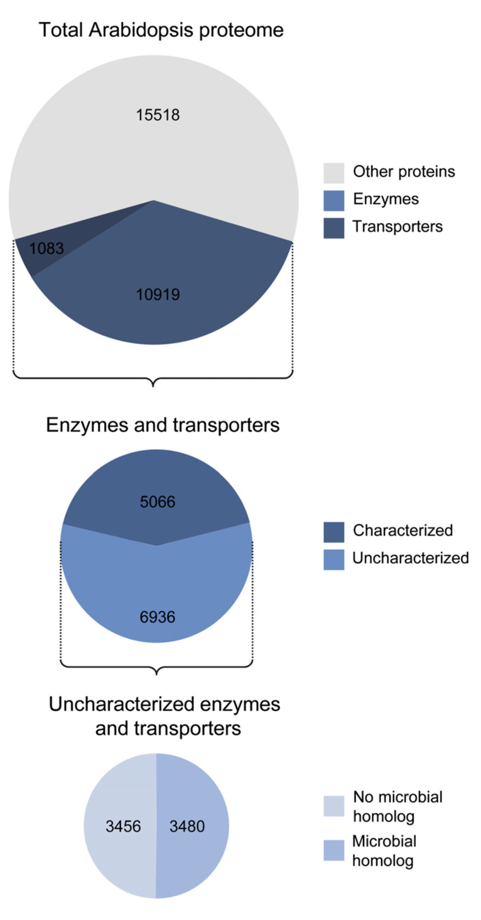
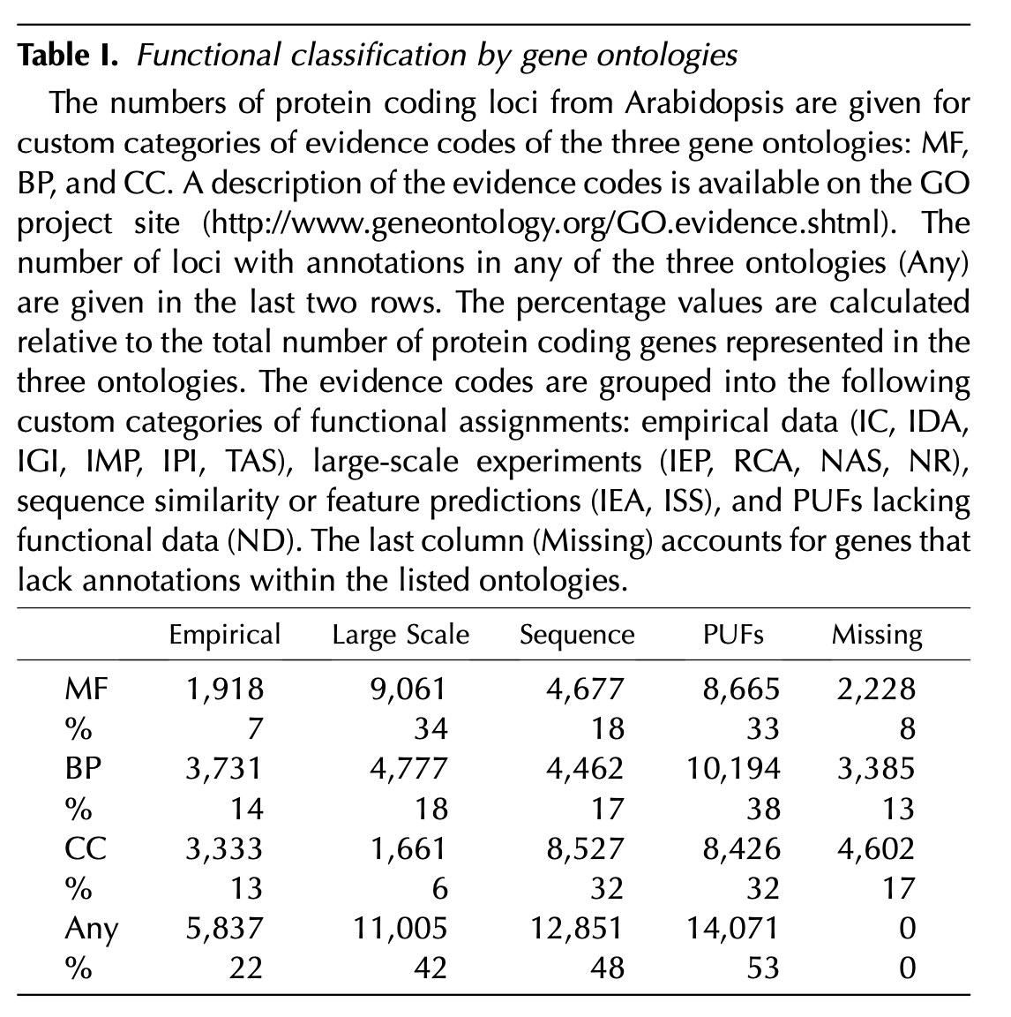
Known Unknowns
We still lack functional data for many genes
Horan et al. (2008) Plant Physiology
Neihaus et al. (2015) Plant Physiology

Slide 4
Gene Ontology
Nested hierarchy of descriptive terms
Each set of terms is assigned an accession
Example: GO:0006979 = “response to oxidative stress”
Lower level terms are more specific
Contain fewer genes
Higher level terms encompass many lower level terms and more genes
Not one-to-one mapping
Multiple terms can map to each other
Genes can map to multiple terms

Slide 5
Gene Ontology
Three broad independent categories
Biological Process
Typically have some sort of experimental evidence
Refers to the actual biological/physiological role
Most informative
Molecular Function
Describes biochemical properties
Most often based on protein domains or homology (to some extent direct experimental evidence)
Cellular Component
Where in the cell is it localized?
Often prediction based on signal peptides or other characteristics
Sometimes experimentally based

Slide 6
Gene Ontology Tools
Multiple online resources & tools
These are often limited in plant species they support
Typically do not have the most up to date genome versions or annotations
Not very reproducible (online tools have a way of disappearing)
http://geneontology.org/docs/tools-overview/
http://pantherdb.org
http://cbl-gorilla.cs.technion.ac.il
http://biit.cs.ut.ee/gprofiler/gost
http://ontologizer.de
https://www.geneweaver.org
R packages
Lots of R packages: https://www.bioconductor.org/packages/release/BiocViews.html#___GeneSetEnrichment
I will focus today on topGO

Slide 7
topGO
https://www.bioconductor.org/packages/release/bioc/vignettes/topGO/inst/doc/topGO.pdf
Highly versatile R-based method
Offers many sophisticated types of analyses (e.g. approaches that can take into account the topology)
Code-based (R) which makes it more reproducible and tractable than web-based methods

Slide 8
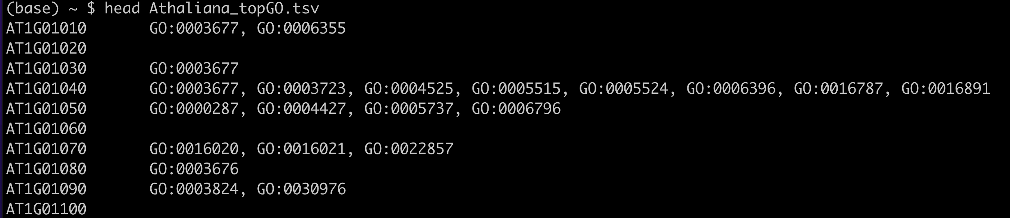
topGO Format
Two tab-separated columns
First is gene name
Second is a list of GO terms separated by a comma and a space

Slide 9
Finding GO Terms
Phytozome – annotation-info files
Genome databases
May have to dig around to find these
http://geneontology.org
PANTHER DB: http://pantherdb.org
BLAST/Orthology/INTERPROSCAN
Reciprocal best BLAST hit or sequence homology to transfer annotations from one species to another
Popular example: Blast2GO: https://www.blast2go.com

Slide 10
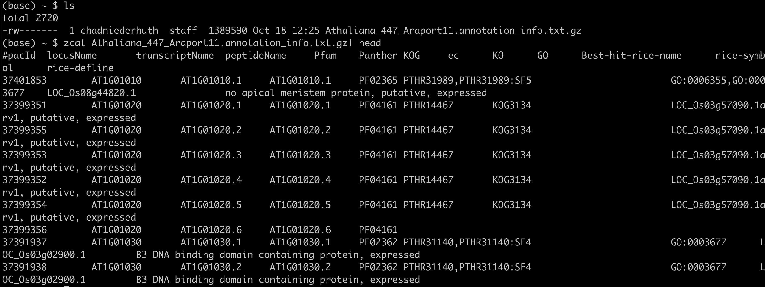
Wrangling your data into format
The gene/transcript names need to match those in your differential expression analyssi
The data we want are column #2 (locus name) & #10 (GO terms)

Slide 11
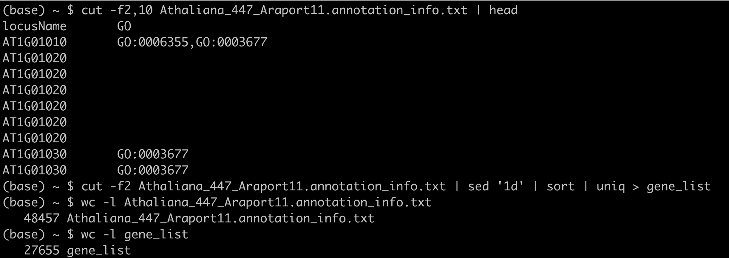
Wrangling your data into format
Notice also that there are multiple instances of a gene, because there are multple transcripts
We will first get a list of only the unique locusName (i.e. gene names)

Slide 12
Wrangling your data into format
Next we will use a “while” to go over the gene list, get the entires for that gene, extract the unique GO terms,
reformat and output to a new file
This results in a file that looks like this

Slide 13
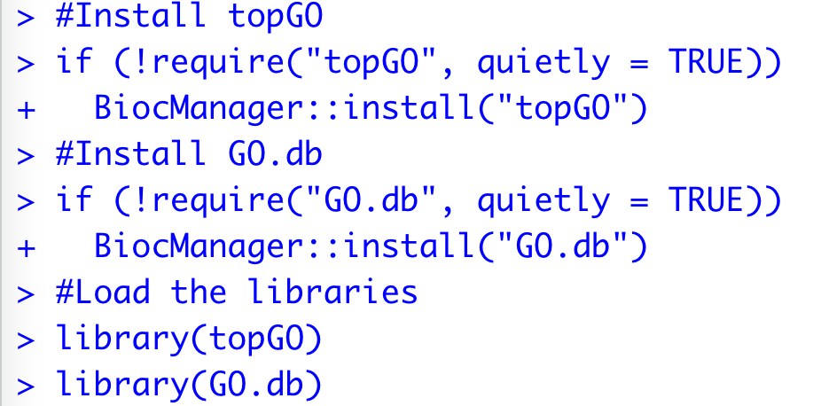
Installation & Loading
We will install both topGO and GO.db
GO.db is an R package that provides database access to GO terms and their functional descriptions

Slide 14
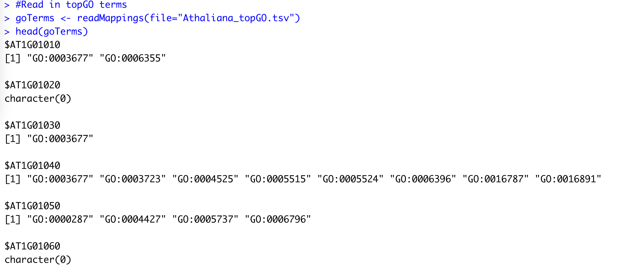
Read in GO terms
readMappings()

Slide 15
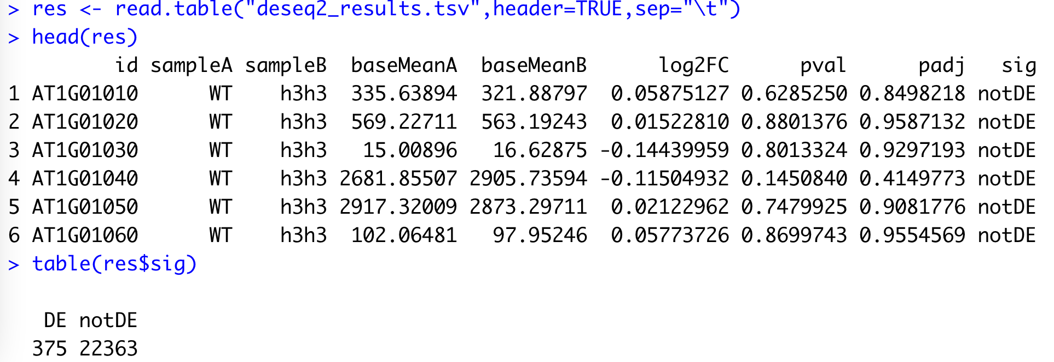
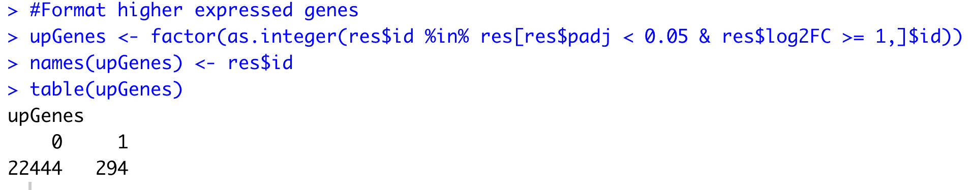
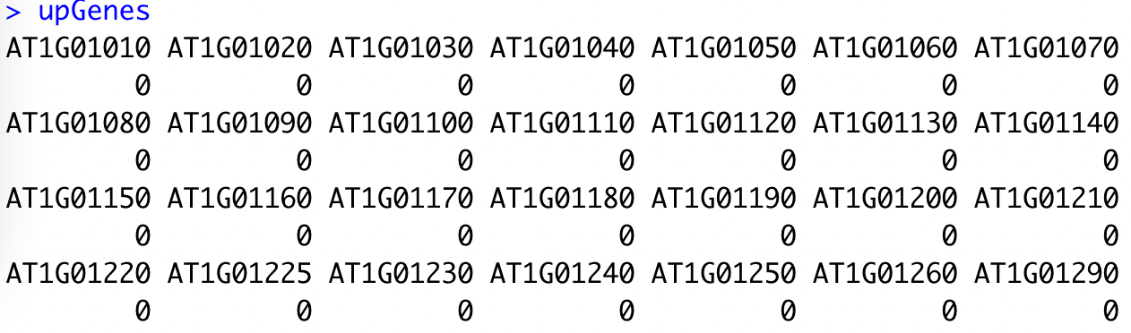
Gene Lists
Vector
0 = not DEG
1 = DEG
names = gene names
This does not have to be differentially expressed genes
Your genes assigned value ‘1’ can be anything
GWAS hits
QTL genes
some other source

Slide 16
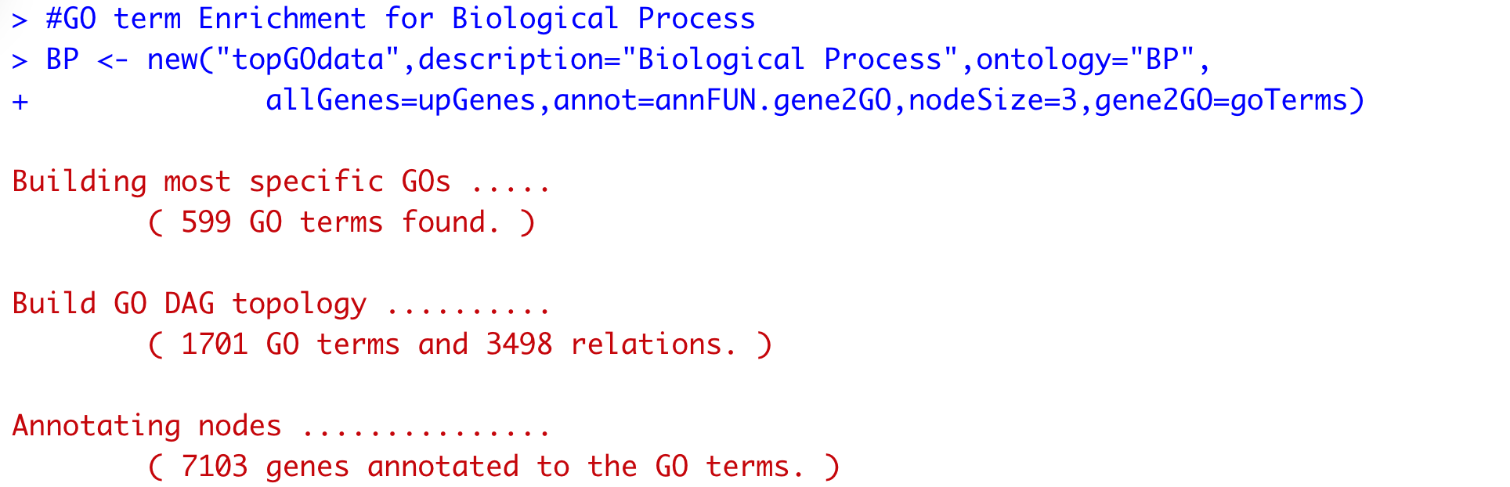
create the topGO object
new()
This step is limited to one of the three categories
Biological Process (BP)
Molecular Function (MF)
Cellular Component (CC)
Maps the gene list onto the goTerms and filters go terms based on a given node size (e.g. number of genes)
Common to filter go terms with low numbers of genes (not very informative)

Slide 17
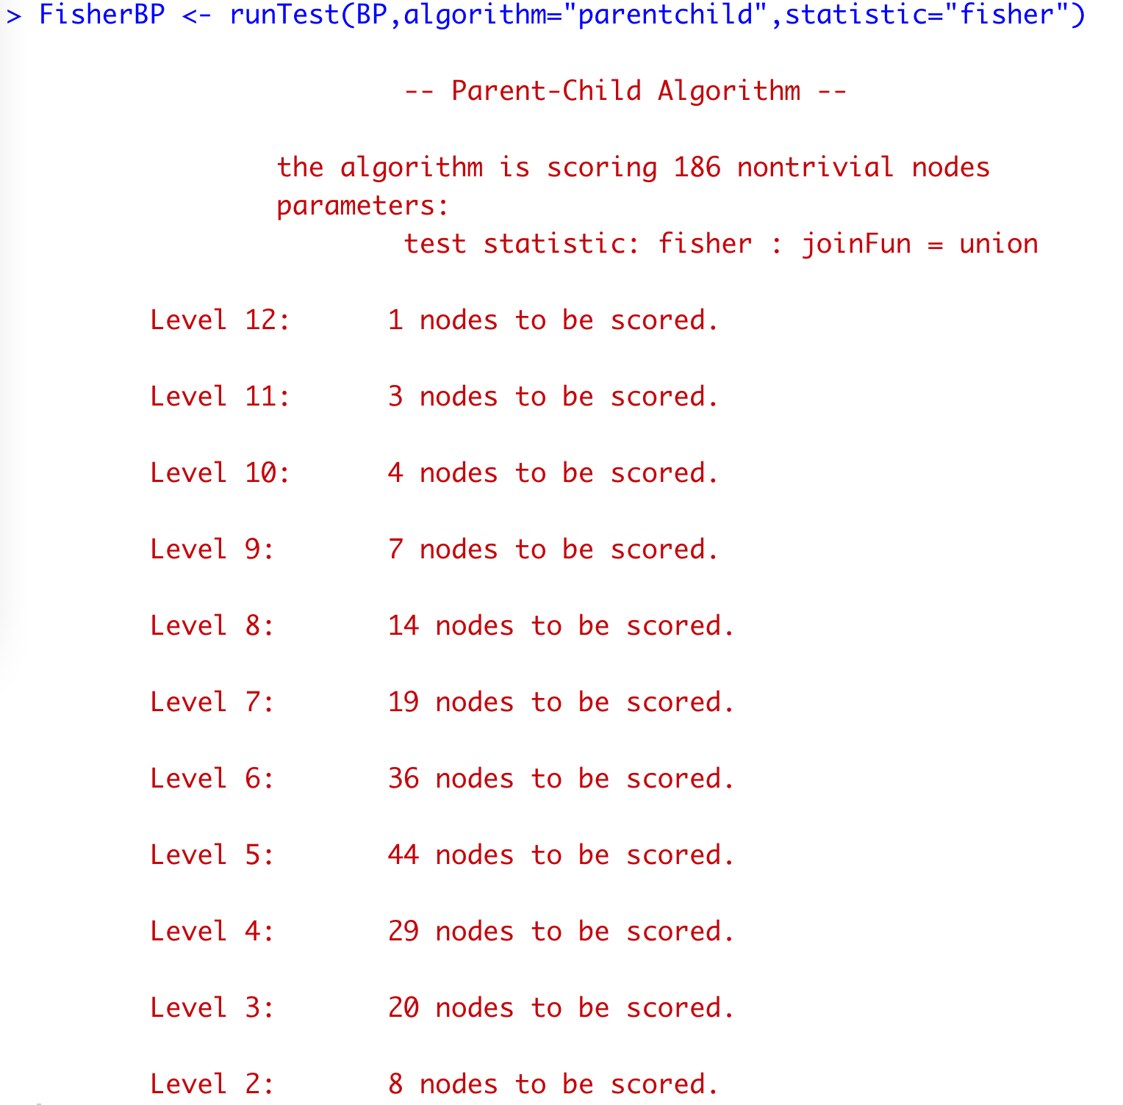
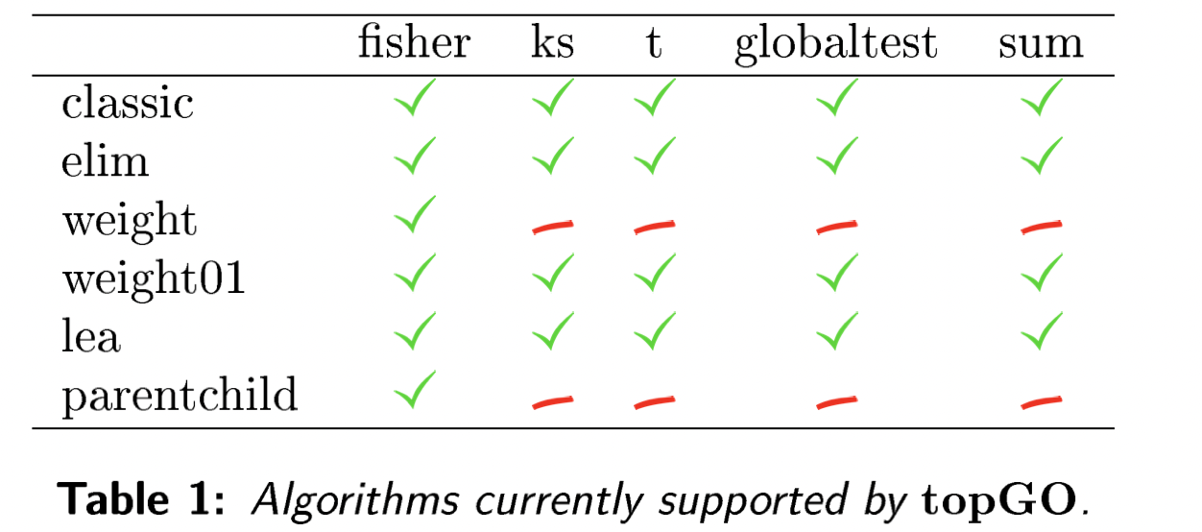
Enrichment Test
runTest()
Performs the enrichment test
Multiple methods available in topGO
https://www.bioconductor.org/packages/release/bioc/vignettes/topGO/inst/doc/topGO.pdf

Slide 18
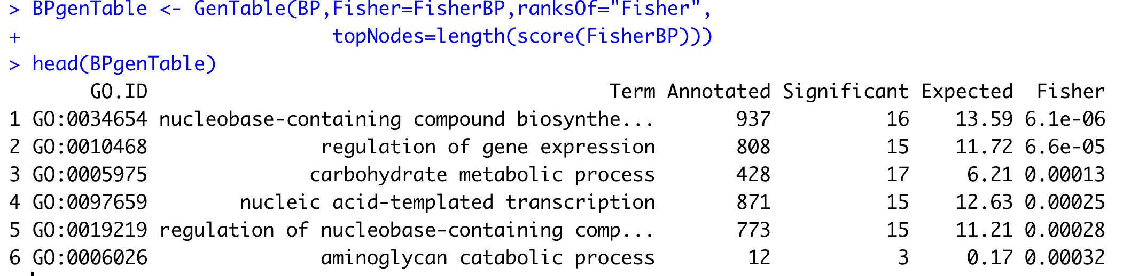
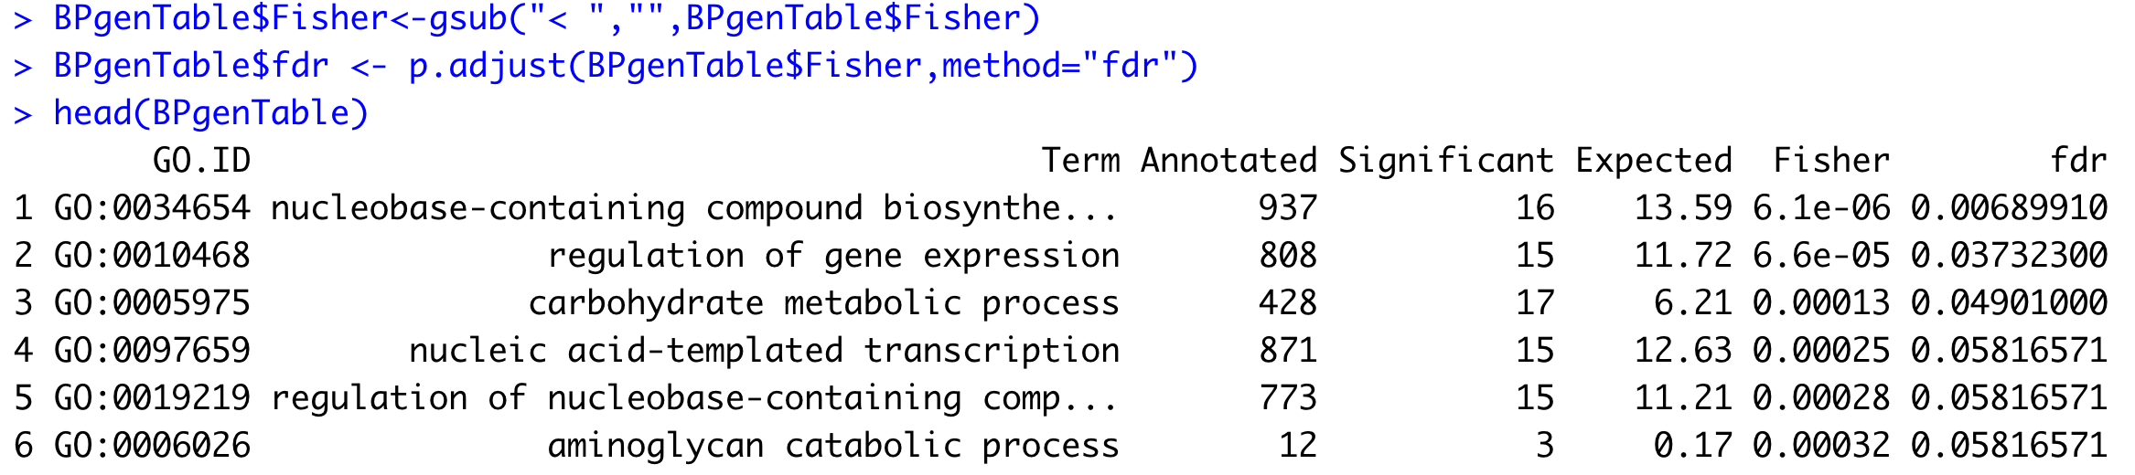
Extract the GO term table
GenTable()
Converts to a more readable table
Have to manually perform multiple testing correction

Slide 19
Multiple Testing Correction in GO terms
Somewhat debatable if you should perform multiple testing correction or not.
Run real risk of not finding any significant GO terms
GO enrichment tests typically result in rather moderate p-values
Its not clear if the assumptions of standard multiple testing correction methods apply
GO terms typically not based on “raw data”, but performed on data that has already been filtered through one or more statistical tests
Multiple testing typically assumes each p-value result of an independent test. This is true for classical GO term enrichment, but not for more advanced approaches that take into account the GO term hierarchy
I have done with and without

Slide 20
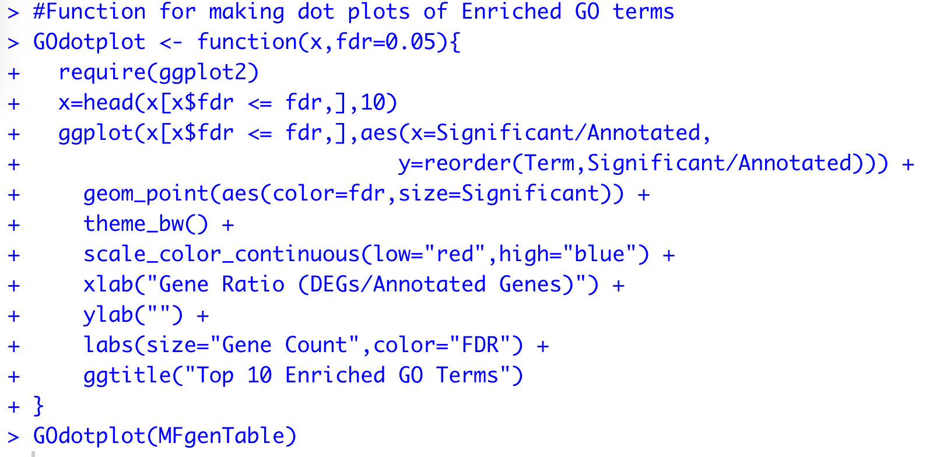
Visualizing GO terms
Multiple ways to visualize GO terms
None of them fully satisfying
GO terms have multiple levels of information
Topology
How large the GO term is
Degree of enrichment (ratio of genes to total genes)
Always at least provide supplementary tables of the GO term Enrichment

Slide 21
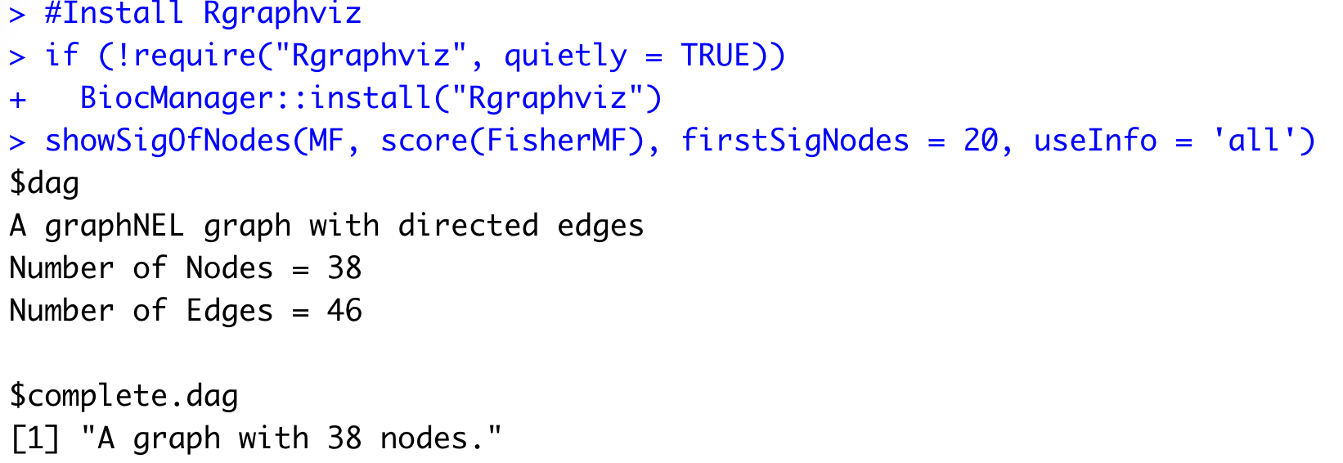
Visualizing GO terms
GO terms are also commonly as part of their topology/hierarchical organization
This gets messy really quick when there are lots of terms or lots of dispersed low-level terms

Slide 22
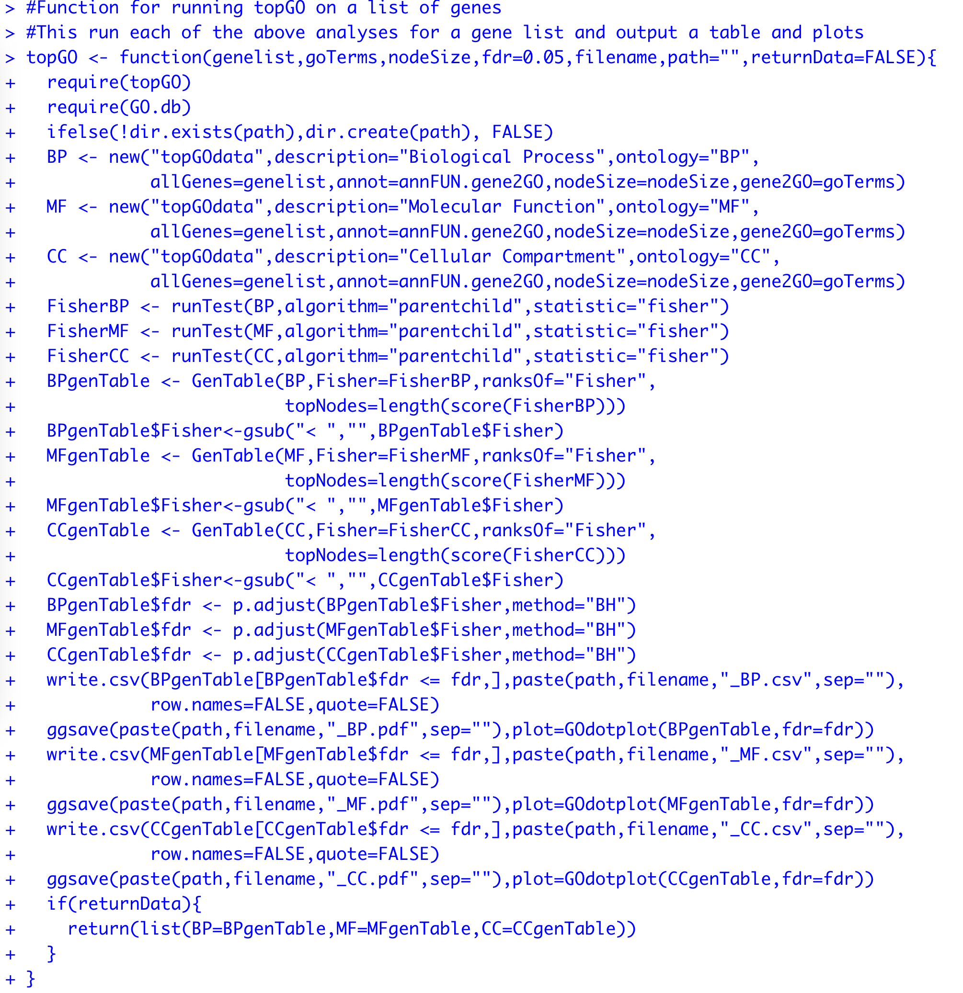
Combining the steps into a single function

Slide 23
Upcoming
Work on your proposals ~ 1 month left!
Today
Office hours 12-1
Lab Assignment #5 Due @ 5pm
Lab Assignment #6 Assigned
Monday 10/24 Break
Wednesday 10/26 Exam 1

